Slide 1
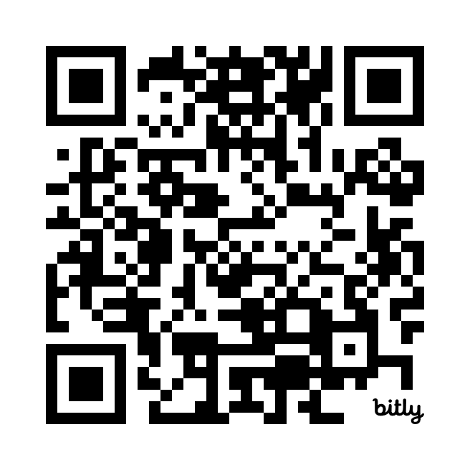
GitHub Copilot 1 Quiz
https://bit.ly/40BJz2I

